Slide 1
PHY 211: Elementary modern Physics (2 Units)
Work, Energy and theory of relativity (week 2)
DR OKAFOR P.N.
DEPARTMENT OF PHYSICS
COLLEGE OF SCIENCE AND TECHNOLOGY
CONVENANT UNIVERSITY
2025/2026

Slide 2
OBJECTIVES
Students are able to calculate work, energy and momentum using relativistic principles
Explain the difference in relativity and Newtonian mechanics

Slide 3
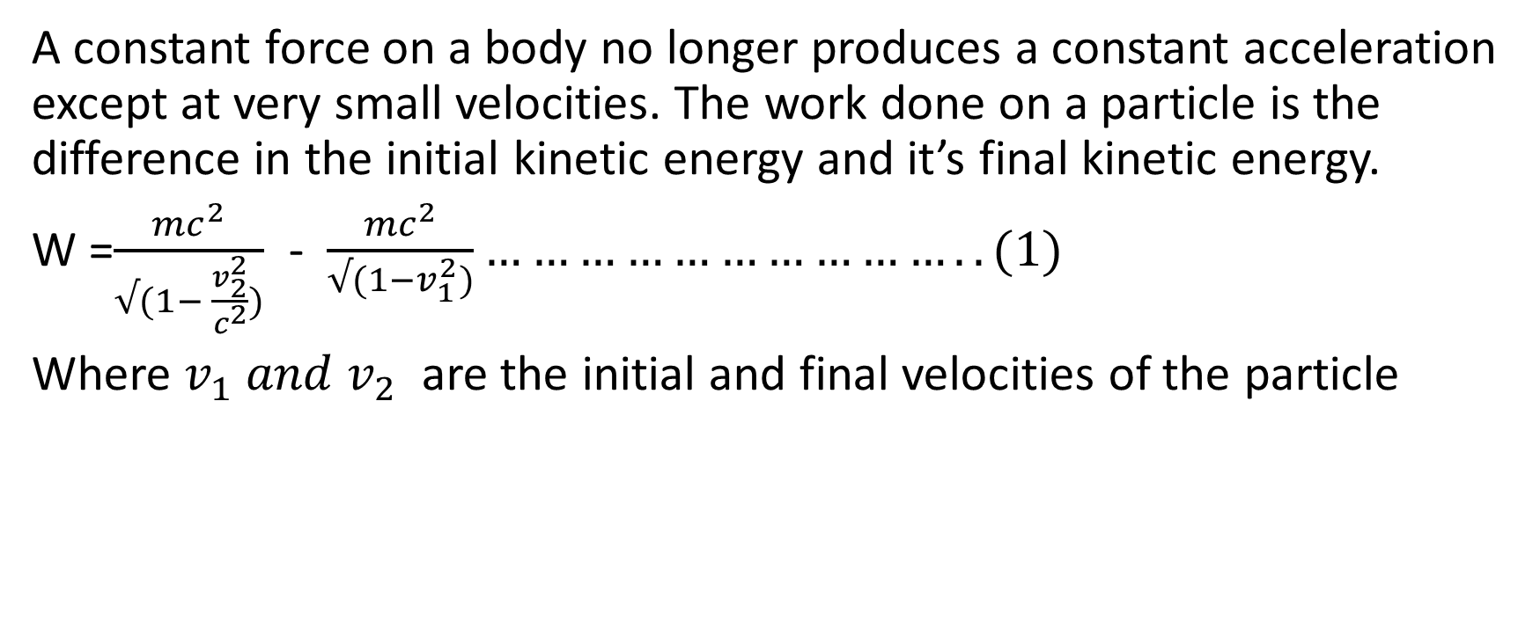
Work , energy and relativity
A constant force on a body no longer produces a constant acceleration except at very small velocities. The work done on a particle is the difference in the initial kinetic energy and it’s final kinetic energy.
W =$\frac{{mc}^{2}}{√(1− \frac{v_{2}^{2}}{c^{2}})}$ - $\frac{{mc}^{2}}{√(1−v_{1}^{2})}…………………………..(1)$
Where $v_{1} and v_{2}$ are the initial and final velocities of the particle

Slide 4
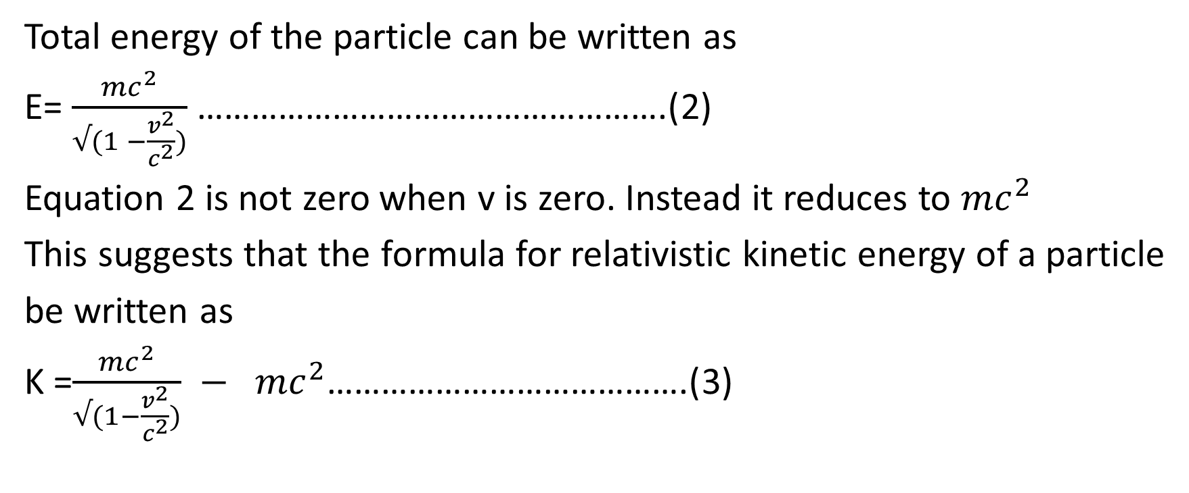
Work and energy
Total energy of the particle can be written as
E= $\frac{{mc}^{2}}{√(1 −\frac{v^{2}}{c^{2}})}$ …………………………………………….(2)
Equation 2 is not zero when v is zero. Instead it reduces to ${mc}^{2}$
This suggests that the formula for relativistic kinetic energy of a particle
be written as
K =$\frac{{mc}^{2}}{√(1−\frac{v^{2}}{c^{2}})} − {mc}^{2}$………………………………….(3)

Slide 5
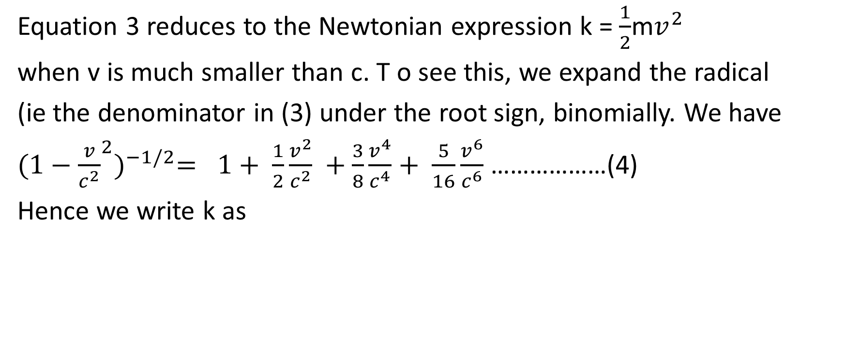
Work and energy
Equation 3 reduces to the Newtonian expression k = $\frac{1}{2}$m$v^{2}$
when v is much smaller than c. T o see this, we expand the radical
(ie the denominator in (3) under the root sign, binomially. We have
${(1−{\frac{v}{c^{2}}}^{2})}^{−1/2}= 1+ \frac{1}{2}\frac{v^{2}}{c^{2}} +$ $\frac{3}{8}\frac{v^{4}}{c^{4}}+ \frac{5}{16}\frac{v^{6}}{c^{6}}$………………(4)
Hence we write k as

Slide 6
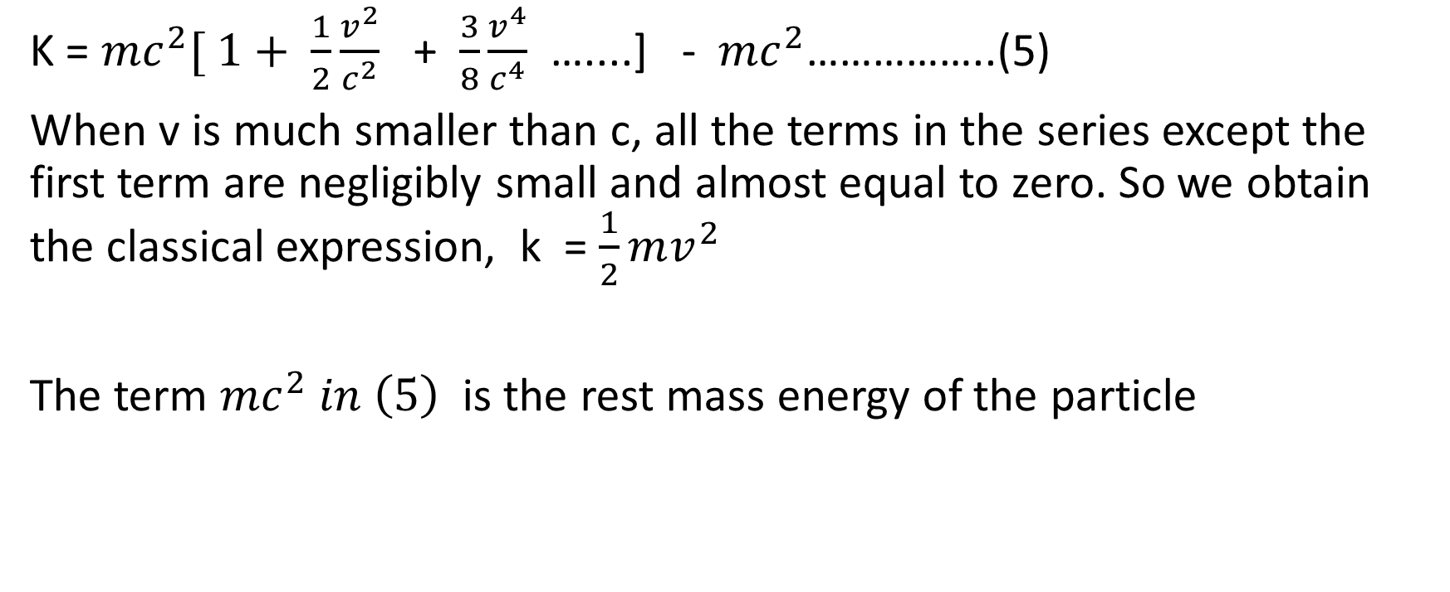
Work and energy
K = ${mc}^{2}[ 1+ \frac{1}{2}\frac{v^{2}}{c^{2}}$ + $\frac{3}{8}\frac{v^{4}}{c^{4}}$ …....] - ${mc}^{2}$……………..(5)
When v is much smaller than c, all the terms in the series except the first term are negligibly small and almost equal to zero. So we obtain the classical expression, k = $\frac{1}{2}mv^{2}$
The term ${mc}^{2} in \left(5\right)$ is the rest mass energy of the particle

Slide 7
Work and energy
In atomic fission, the uranium nucleus undergoes fission such that the mass of the products is less than the mass of the reactants. The mass deficit is converted to energy. This energy can be used to produce steam used to power turbines to produce electricity in nuclear reactors

Slide 8
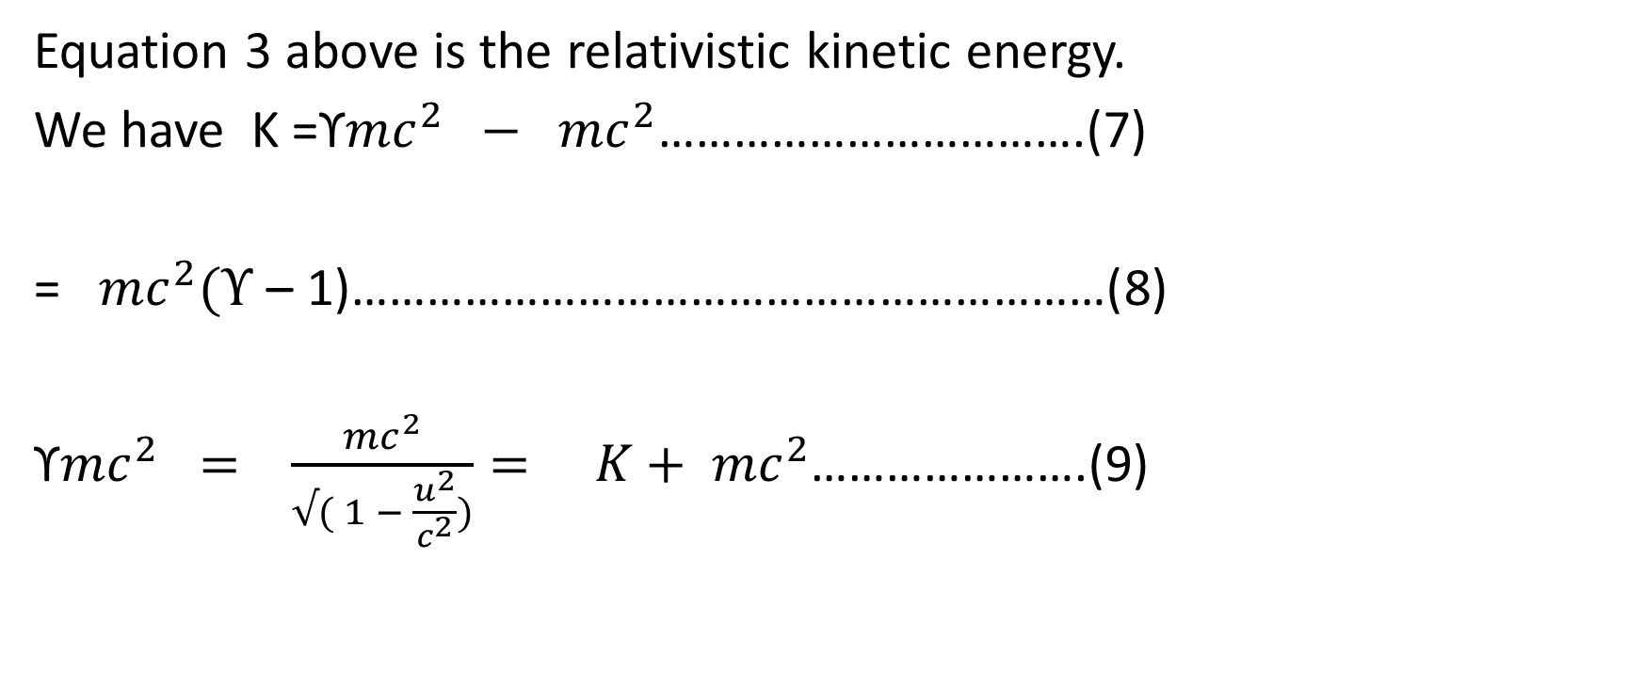
Total Energy and rest Energy
Equation 3 above is the relativistic kinetic energy.
We have K =ϒ${mc}^{2} − {mc}^{2}$…………………………….(7)
= ${mc}^{2}(ϒ$ – 1)……………………………………………………(8)
ϒ${mc}^{2} = \frac{{mc}^{2}}{√( 1 − \frac{u^{2}}{c^{2}})}= K+ {mc}^{2}$………………….(9)

Slide 9
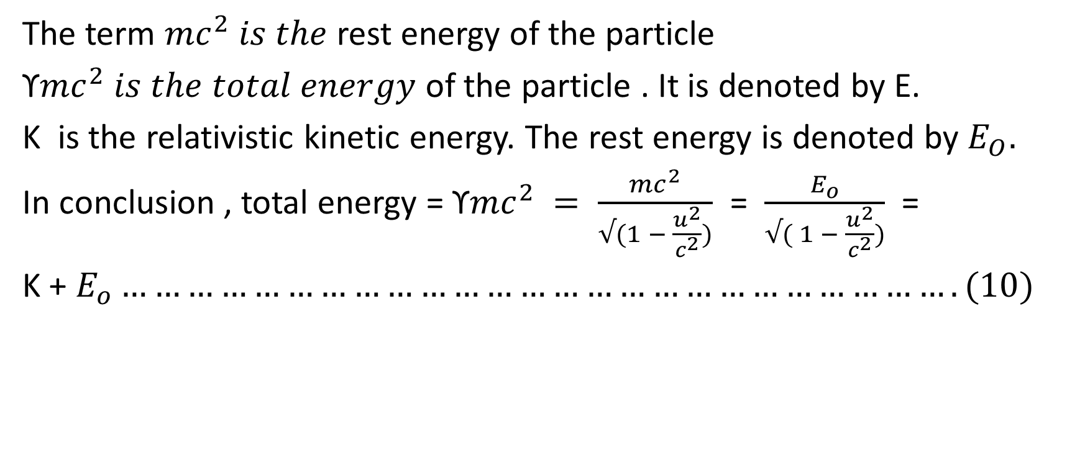
Rest energy and total energy
The term ${mc}^{2} is the$ rest energy of the particle
ϒ${mc}^{2} is the total energy$ of the particle . It is denoted by E.
K is the relativistic kinetic energy. The rest energy is denoted by $E_{O}.$
In conclusion , total energy = ϒ${mc}^{2} = \frac{{mc}^{2}}{√(1 − \frac{u^{2}}{c^{2}})}$ = $\frac{E_{o}}{√( 1 − \frac{u^{2}}{c^{2}})}$ =
K + $E_{o}………………………………………………………………….(10)$

Slide 10
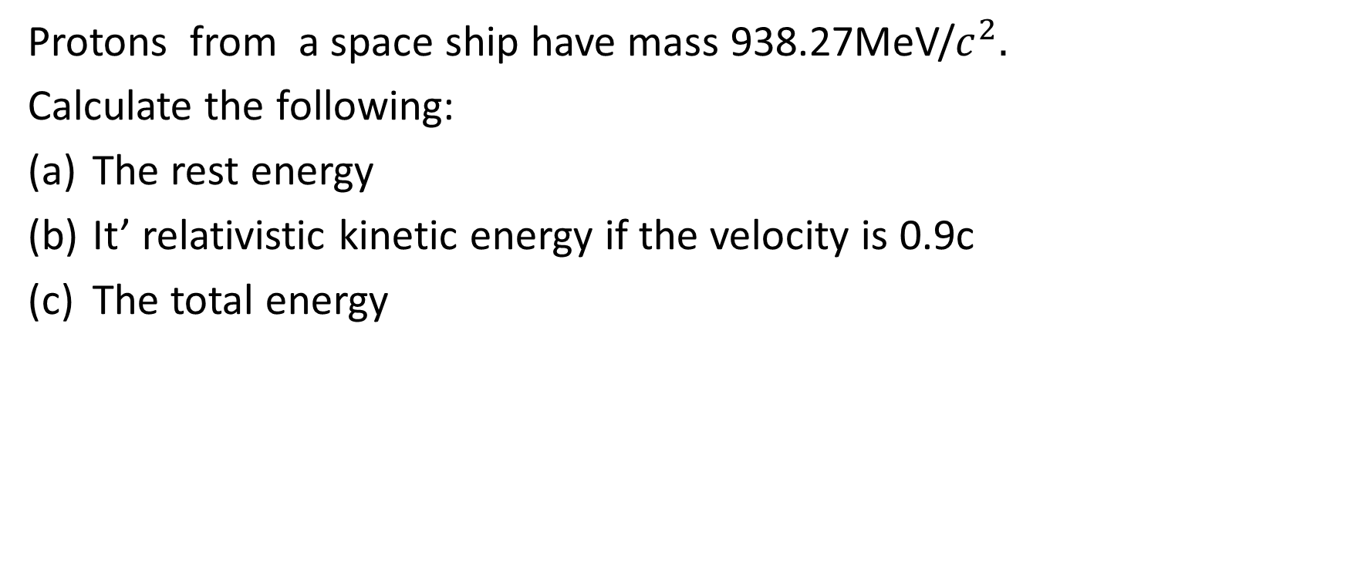
Worked example
Protons from a space ship have mass 938.27MeV/$c^{2}.$
Calculate the following:
The rest energy
It’ relativistic kinetic energy if the velocity is 0.9c
The total energy

Slide 11
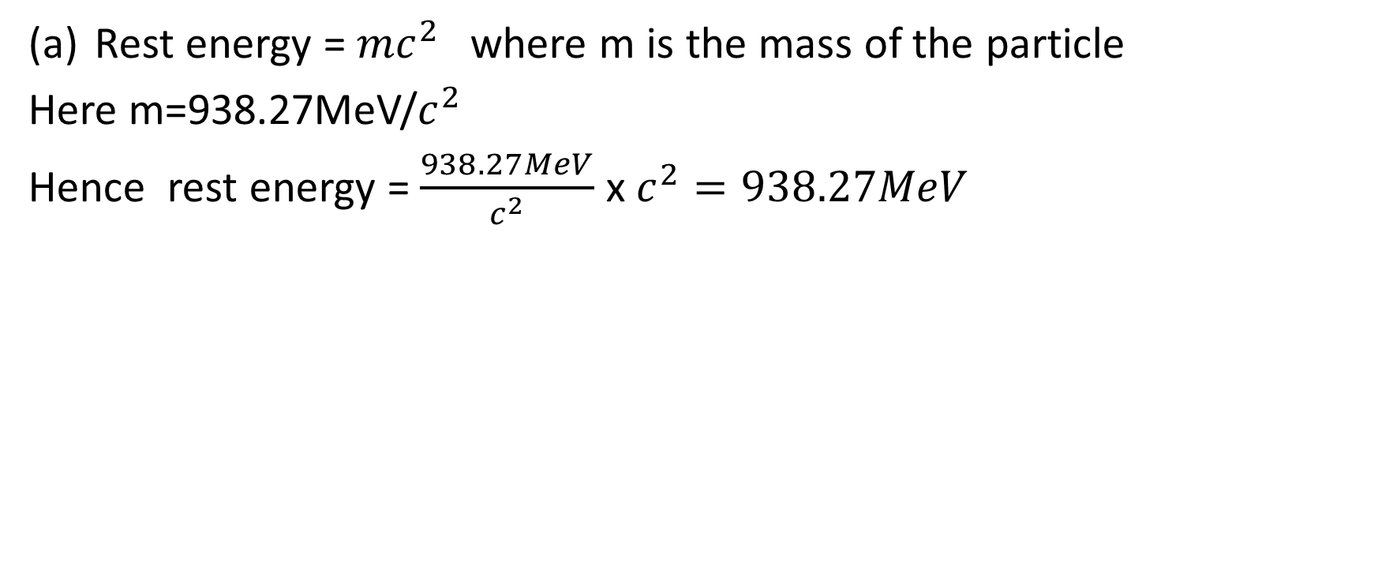
Solution
Rest energy = ${mc}^{2}$where m is the mass of the particle
Here m=938.27MeV/$c^{2}$
Hence rest energy = $\frac{938.27MeV}{c^{2}}$ x $c^{2}=938.27MeV$

Slide 12
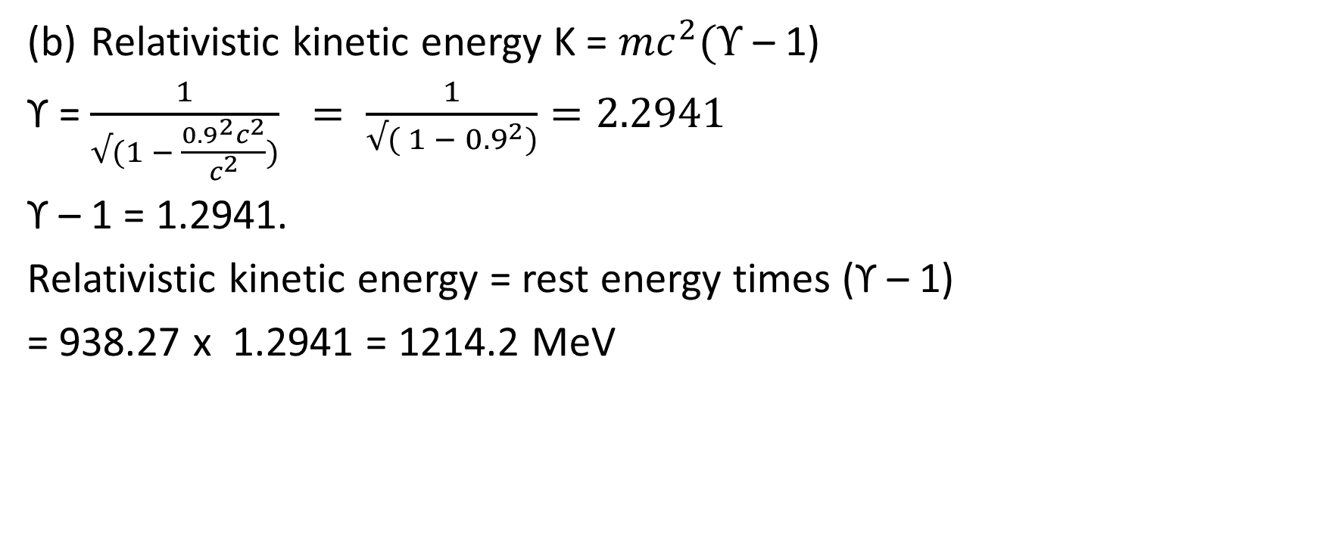
Solution to worked example
Relativistic kinetic energy K = ${mc}^{2}(ϒ$ – 1)
ϒ = $\frac{1}{√(1 − \frac{{0.9}^{2}c^{2}}{c^{2}})} = \frac{1}{√( 1 − {0.9}^{2})}=2.2941$
ϒ – 1 = 1.2941.
Relativistic kinetic energy = rest energy times (ϒ – 1)
= 938.27 x 1.2941 = 1214.2 MeV

Slide 13
Solution to worked example
( c) Total energy = rest energy + kinetic energy
= 1214 + 938.27 = 2152.27MeV

Slide 14
Relativity and Newtonian mechanics
It may appear that the foundations in which Newtonian mechanics are built have been destroyed. While this is true, in one sense, it is essential to know that the formulations of Newtonian mechanics still
retains it’s validity at small speeds.
Relativity does not contradict Newtonian mechanics, but generalizes it.
Newtonian mechanics is based on experimental evidence. Every new theory must pass this test, called the correspondence principle

Slide 15
Relativity and Newtonian mechanics
There are many problems for which Newtonian mechanics is clearly inadequate. This includes all situations where the particle’s speed approaches that of light or where there is conversion of mass to energy.
But there is still a large area in which Newtonian mechanics is still adequate eg in the behavior of macroscopic bodies. The basic ideas of the general theory of relativity are now well established, but some of the details remain speculative in nature.

Slide 16
Relativity and Newtonian mechanics
Its chief application is in the cosmological investigations of the structure of the universe, the formation and evolution of the stars.
It is not believed to have any relevance for atomic or nuclear phenomena or macroscopic mechanical problems of less than astronomical phenomena

Slide 17
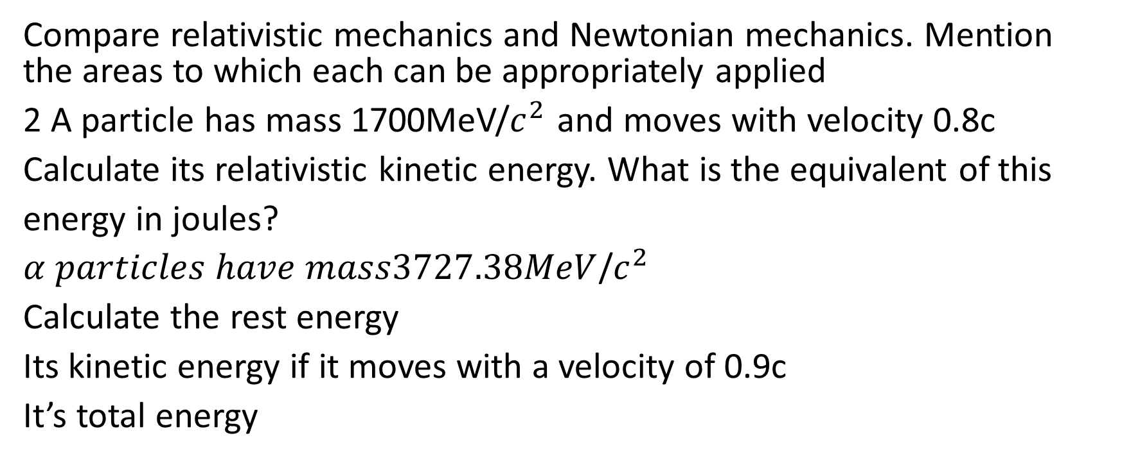
Review Questions
Compare relativistic mechanics and Newtonian mechanics. Mention the areas to which each can be appropriately applied
2 A particle has mass 1700MeV/$c^{2}$ and moves with velocity 0.8c
Calculate its relativistic kinetic energy. What is the equivalent of this
energy in joules?
$α particles have mass3727.38MeV$/$c^{2}$
Calculate the rest energy
Its kinetic energy if it moves with a velocity of 0.9c
It’s total energy

